Slide 1
UI Core Components & Flexbox Layouts
Building Responsive Mobile Interfaces

Slide 2
Introduction to JSX Syntax & Core ui components

Slide 3
React vs React Native Libraries
HTML / React Web | React Native
<div> | <View>
<p> | <Text>
<h1> | <Text> with styling
<img> | <Image>
<input> | <TextInput>
<button> | <Button> / (<Pressable> / <TouchableOpacity>)

Slide 4
Component | What It Is | How to Use It
<View> | The fundamental container. Equivalent to a <div> in web development. | Wrapping other components or creating boxes/cards.
<Text> | The only component that can display words. | Wrapping any string of text.
<Image> | Displays local or web images. | Requires a source prop (e.g., source={{uri: 'url'}}).
<TextInput> | A field for users to type data into. | Capturing passwords, usernames, or search queries.
<TouchableOpacity> | A wrapper that makes any view respond to taps. | Creating interactive custom buttons.

Slide 5
The stylesheet api

Slide 6
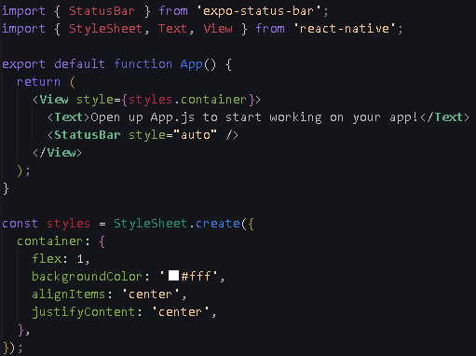
An API or Application Programming Interface is an interface that allows one piece of software to interact with another.
The StyleSheet API is React Native's built-in tool that translates JavaScript style objects into the actual native rendering instructions for iOS and Android displays.
You use it by importing StyleSheet from 'react-native', calling StyleSheet.create({ ... }), and passing the resulting objects to your components via the style prop.

Slide 7
Mastering Flexbox

Slide 8
Flexbox is the algorithm used to dynamically space and align items on varying screen sizes.
Mental Checklist:
  What is my main axis? (flexDirection determines if items stack top-to-bottom or left-to-right).
  How are children distributed along it? (justifyContent spaces items out along that main axis).
  How are children positioned across it? (alignItems centers or stretches items perpendicular to the main axis)
  How much space does each child take? (flex, width, height determine the sizing rules).
  How much space exists between/around things? (gap, margin, padding control the breathing room).

Slide 9
